Slide 1
Branching & Merging

Slide 2
Content
Use branches
Compare branches
Merge branches
Resolve conflicts
Undo a faulty merge
Essential tools (stashing, cherry picking)

Slide 3
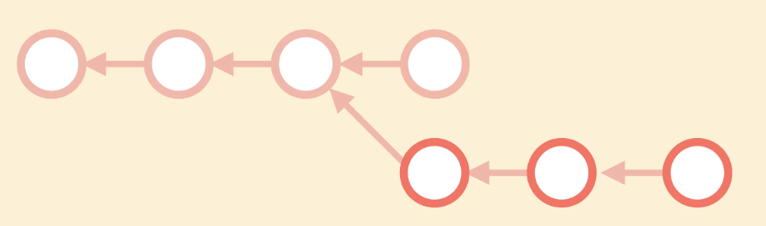

What are Branches?
A separated, isolated workspace from the main workspace.
(e.g.) Create Feature branch to test or develop new features or fix bugs. Once the job is done with the feature branch, it can be merged into the master branch.

Slide 4
What are Branches?
Branching allows us to work on different work items without messing with the main line of work.
We can keep the main line as stable as possible, so we can release it anytime.
Anyone joining the team can start off on a stable codebase.

Slide 5

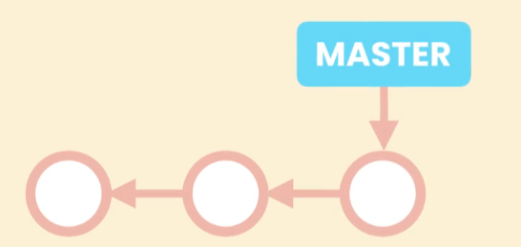
Git Branches are Different
(e.g.) Subversion creates a copy of the entire working directory and stores it somewhere else.
It is slow and takes a lot of space.
Git branch is just a pointer to a commit, and the master branch is just a pointer to the last commit in the main line of work.
As we make new commits, get this pointer forward automatically.

Slide 6
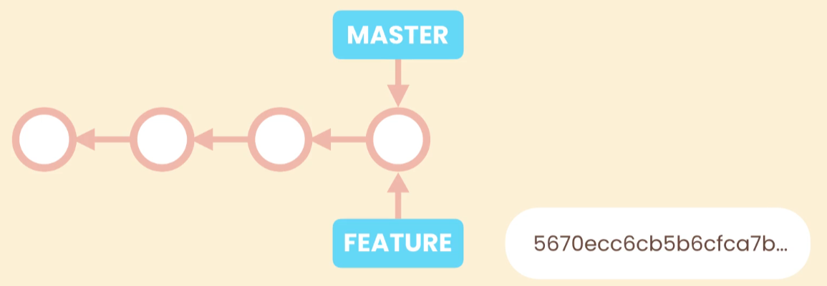
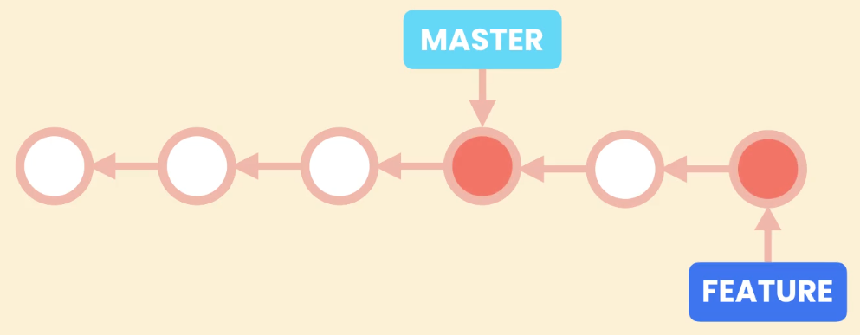
How a new Branch Works in Git
When a new branch is created, the pointer is just a tiny file that contains 40 byte commit ID. That’s why creating a branch is so fast.
When commits are made on the new branch, the pointer moves forward.
The master pointer stays where it is.
Git knows the latest commit of each branch.

Slide 7
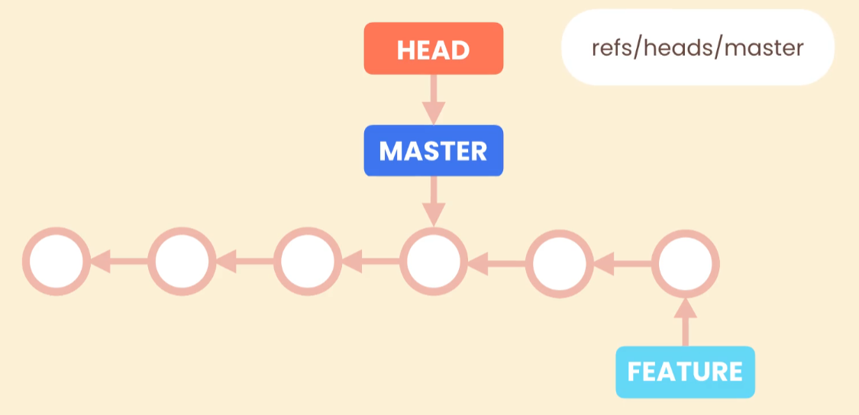
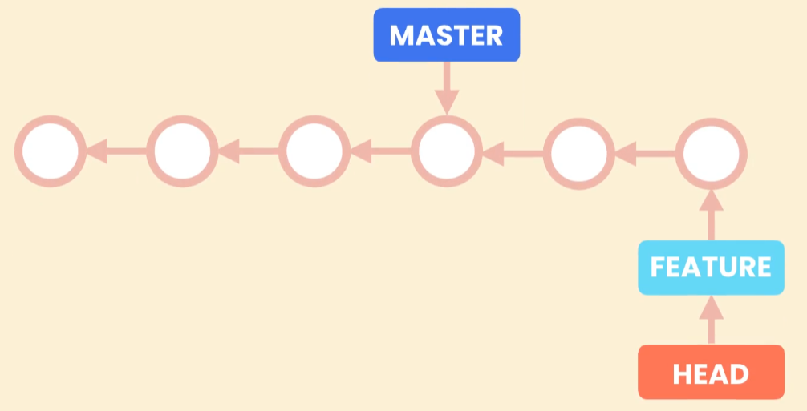
Another pointer ‘HEAD’ is used to know which branch we are currently working on.

Slide 8
Getting a Repository – Venus.zip
Download Venus.zip and unzip it into a directory.
Using Git Bash, navigate to the directory.

Slide 9
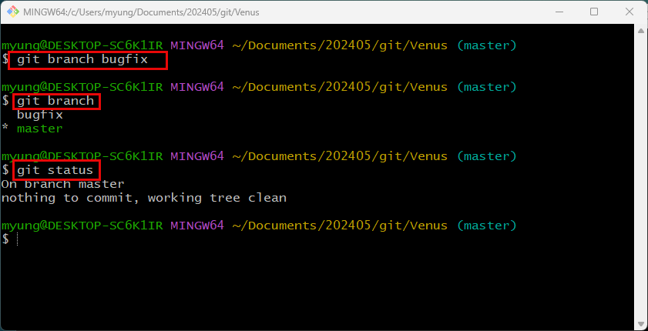
Working with Branches
Create a new branch named ‘bugfix’
List all branches
Currently we are in the master branch.

Slide 10
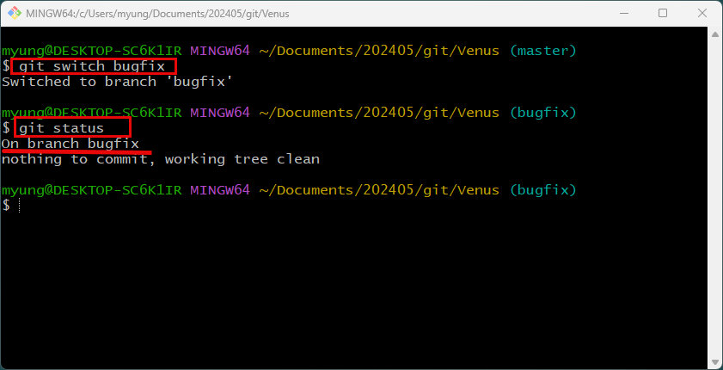
Switching Branches
Can switch to a branch using ‘switch’ command.
‘checkout’ command also can be used.

Slide 11
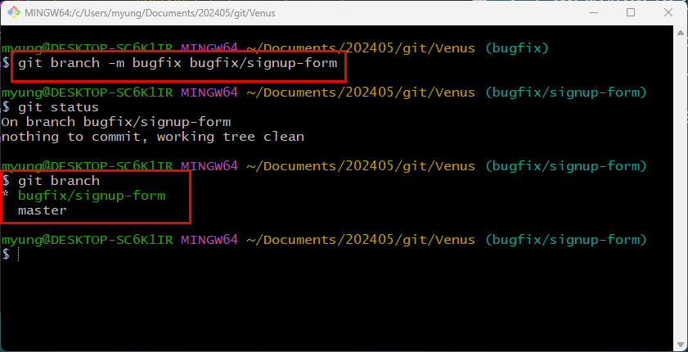
Rename a Branch
Rename ‘bugfix’ to ‘bugfix/signup-form’ to make it more specific.

Slide 12
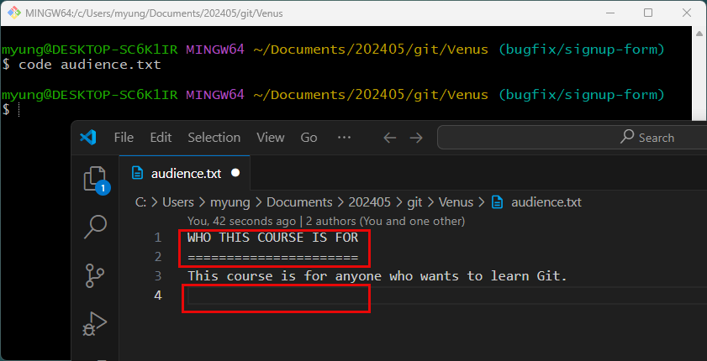
Change the Code
Modification, addition, and deletion were made.

Slide 13
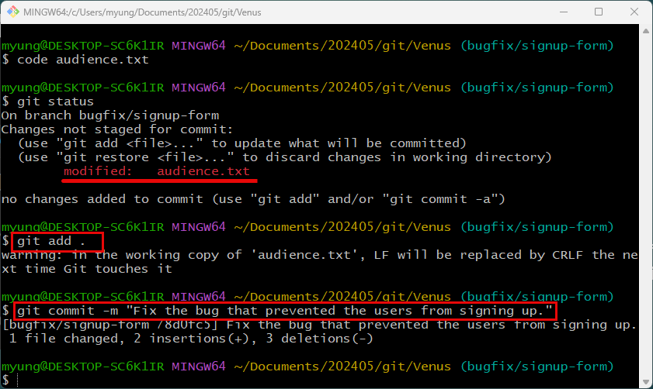
Staging and Commit the Changes

Slide 14
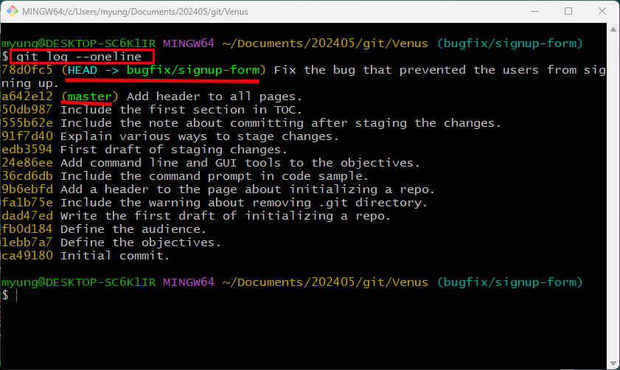

Slide 15
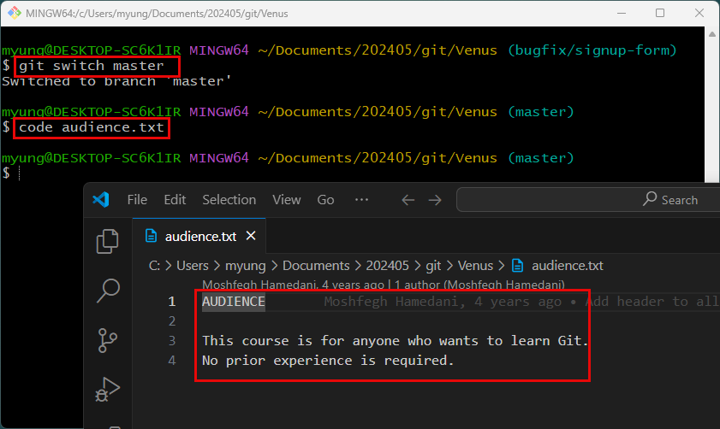
The audience.txt on the master branch wasn’t changed.

Slide 16
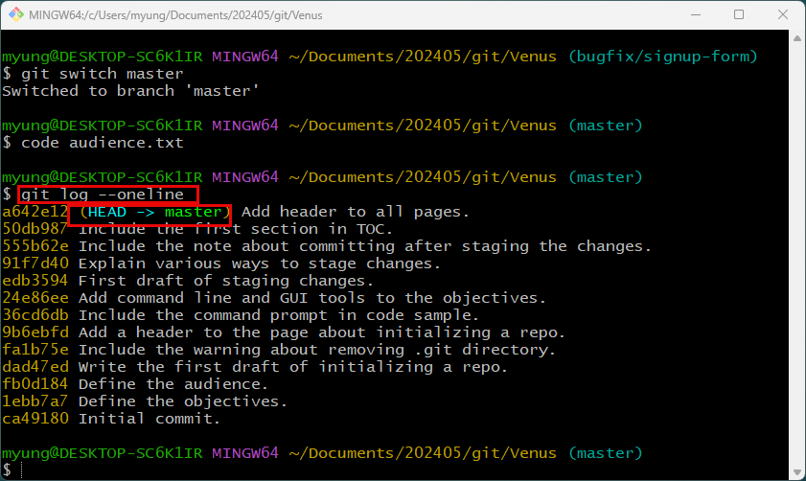
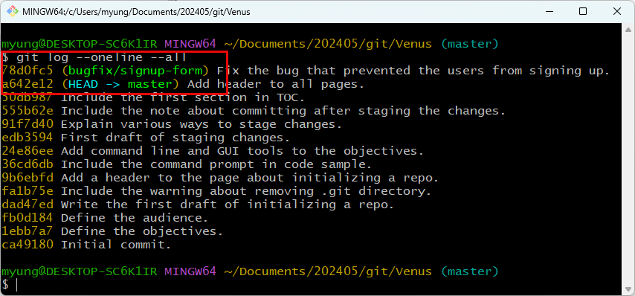

Slide 17
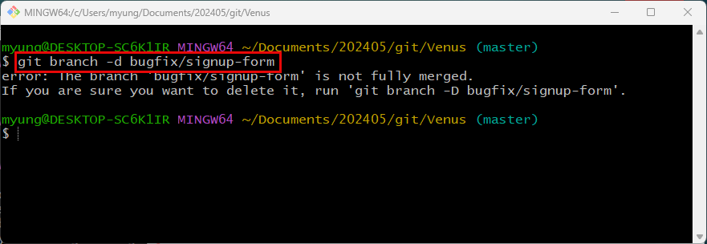
When you accidently delete it, it will throw an error.
If you want to discard the changes, you can use -D option to delete the branch forcefully.

Slide 18
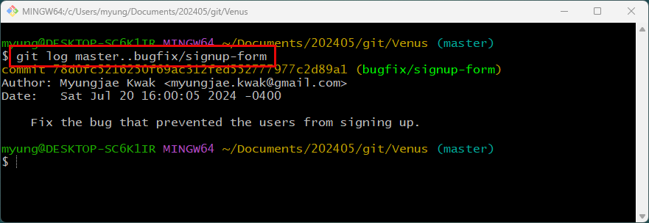
Comparing Branches
To see all commits that are in ‘bugfix/signup-form’ branch but not in ‘master’ branch.

Slide 19
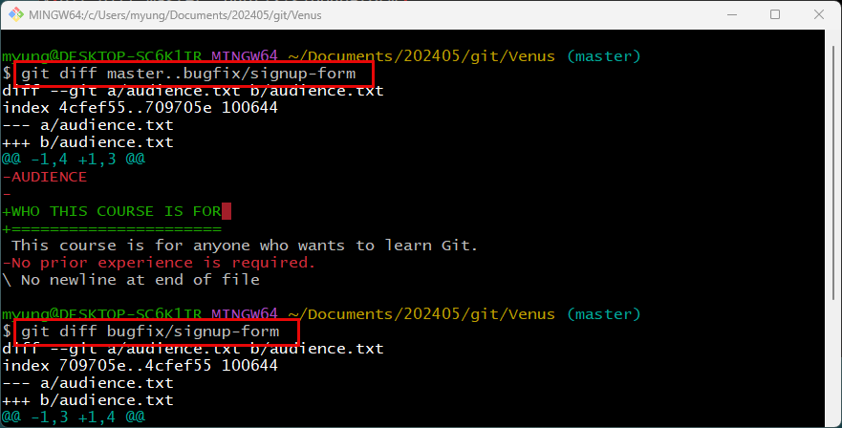

Slide 20
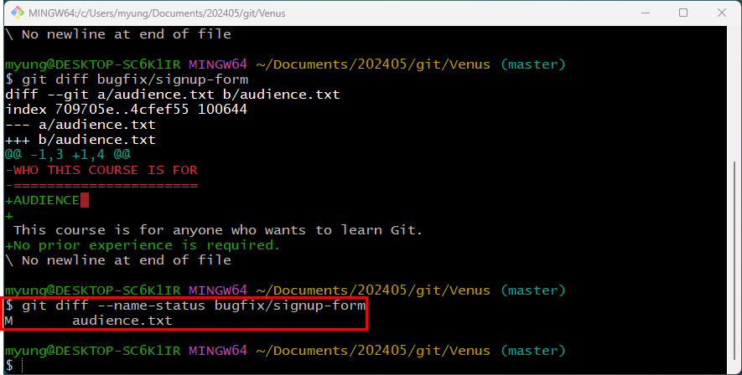

Slide 21
Stashing
When we switch branches, git resets the working directory to the snapshot stored in the commit of the target branch.
If you have local changes in the working directory that you haven’t committed yet, git won’t allow us to switch branches since the changes could get lost.

Slide 22
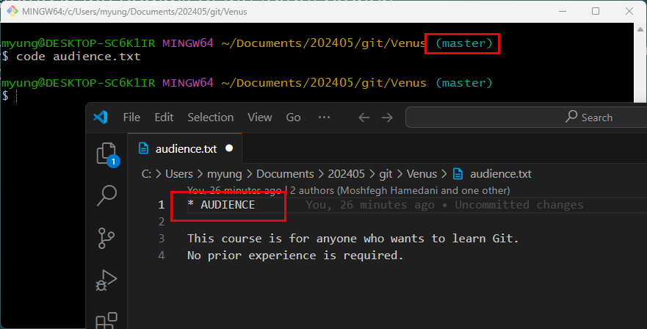
Let’s make some changes on the audience.txt file on ‘master’ branch.
Now, the master branch includes some unstaged changes.

Slide 23
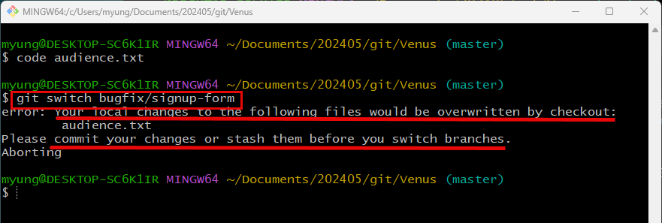
If you try to switch to another branch, it will throw an error.
If you want to save the changes and continue to work on them later, you can stash them.
Stashing means storing them in a safe place. But it is not going to be a part of history.

Slide 24
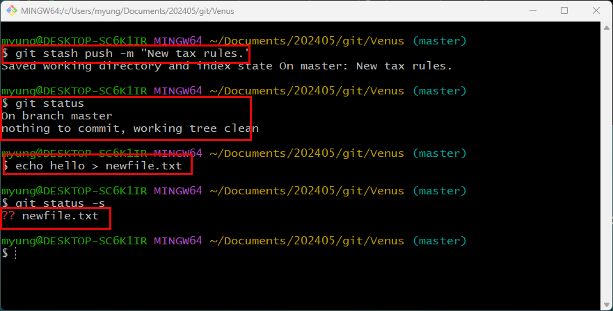

Slide 25
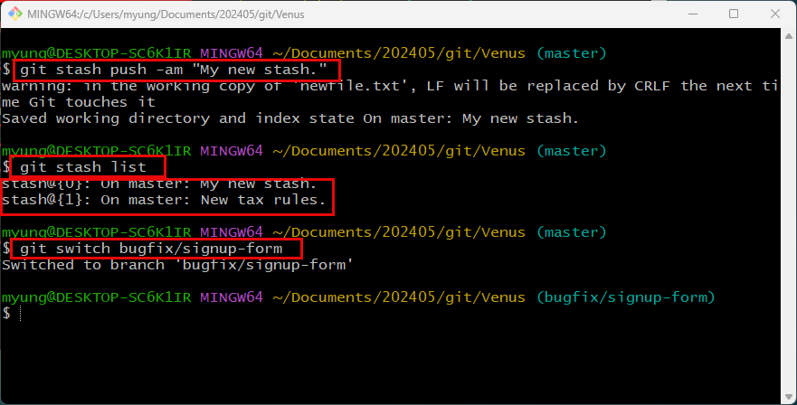
After stashing the untracked changes, now you can switch branches.

Slide 26
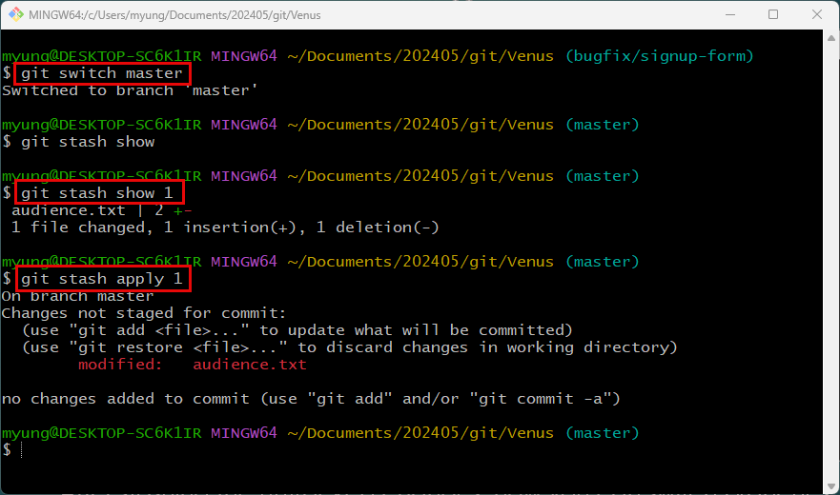
Switch back to master
Show the second stash
Apply the second stash(bring it back to the working directory)

Slide 27
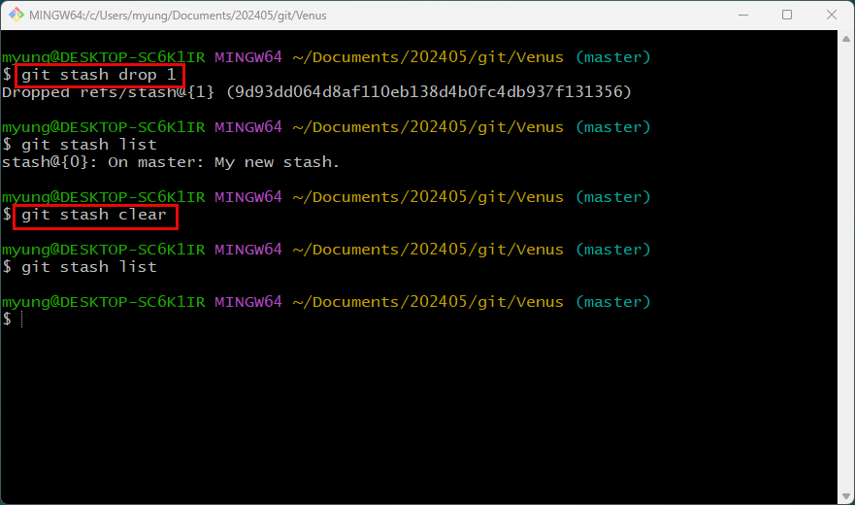
Drop the second stash
Remove all stashes

Slide 28
Merging
Merging is all about bringing changes from one branch to another.
Two types of merges
Fast-forward merges
3-way merges

Slide 29
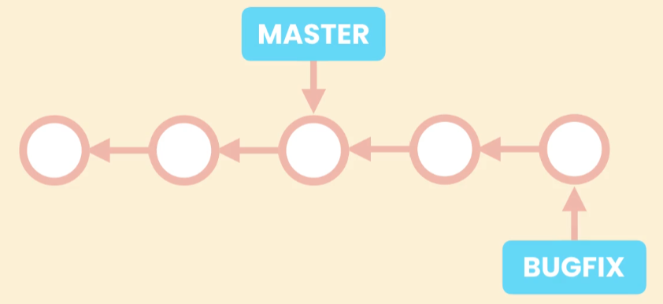
For example, you created a branch named ‘bugfix’ and made a couple of commits on it.

Slide 30
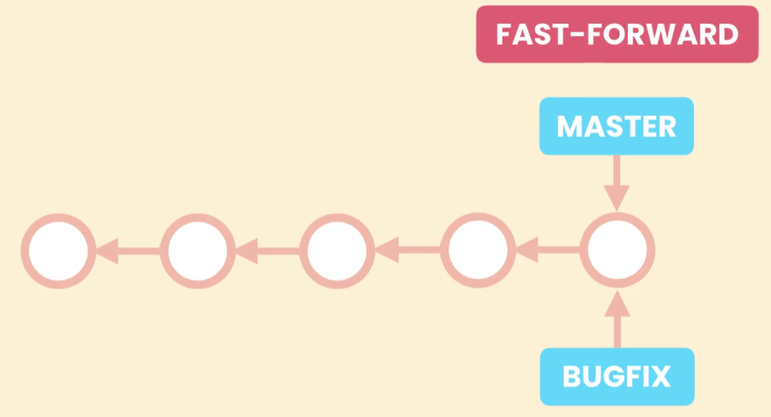
Fast-Forward Merge
Bring the master pointer forward to the branch pointer

Slide 31
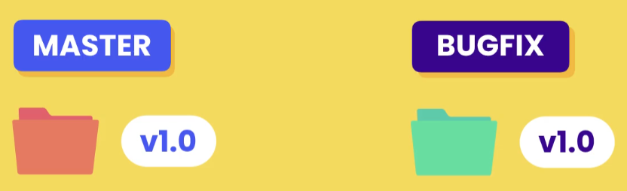
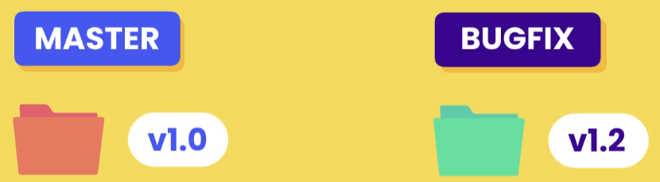
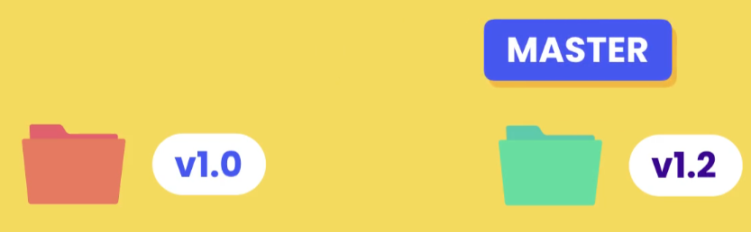
We can simply rename bugfix to master.
Then we can simply remove the bugfix pointer.

Slide 32
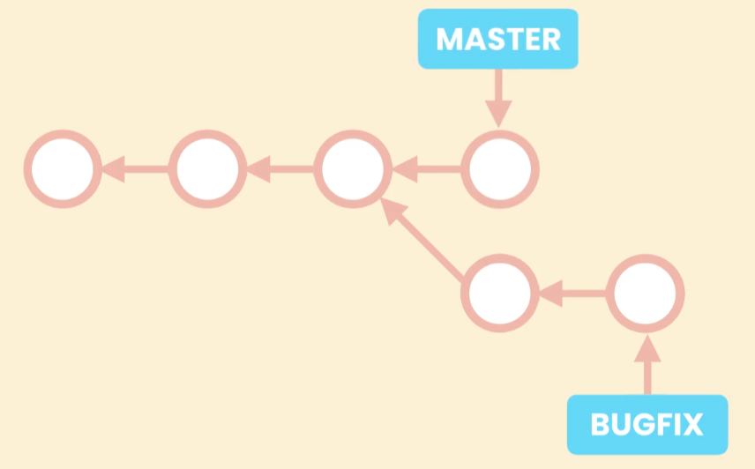
3-Way Merge
After branching, bugfix branch has two additional commits, and master branch as an additional commit.
Two branches diverged.
In this case, you cannot simply move master forward.

Slide 33
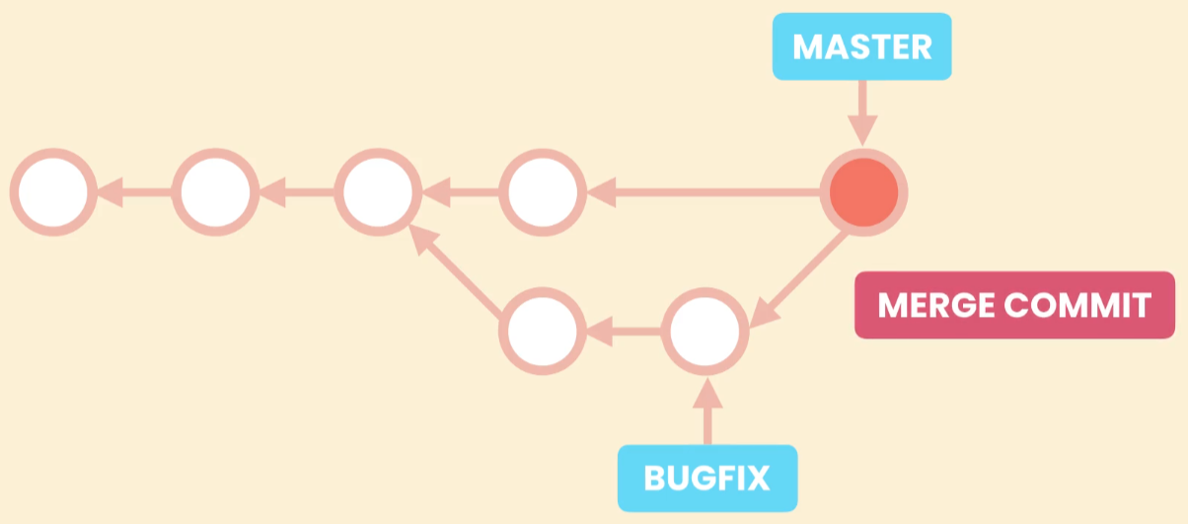
In this case, git creates a new commit to combine the changes from these two branches.
It is called 3-way merge because it is based on three different commits.

Slide 34
Merges
Fast-Forward (if branches have not diverged)
3-way (if branches have diverged)

Slide 35
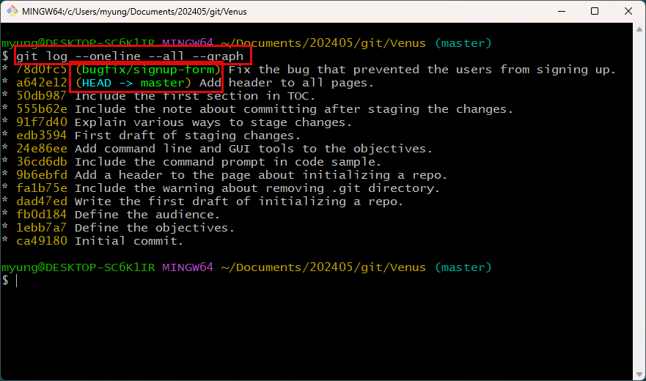
Fast-Forward Merge - Example
The bugfix/signup-form branch is one commit ahead of master branch.

Slide 36
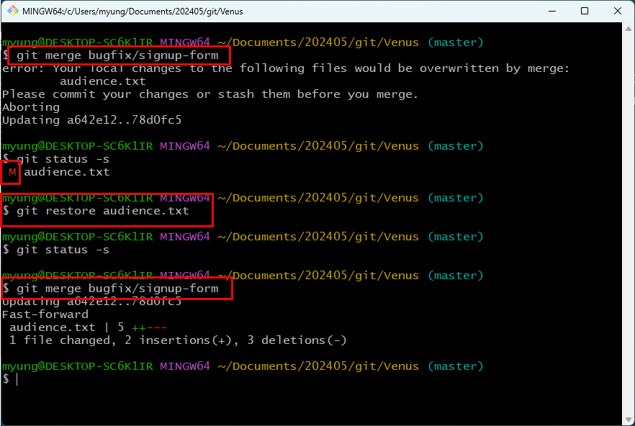
There was uncommitted changes in master branch.
So, discarded the changes using ‘restore’ command.
Now they have not diverged.
So, we can merge them using Fast-Forward method.

Slide 37
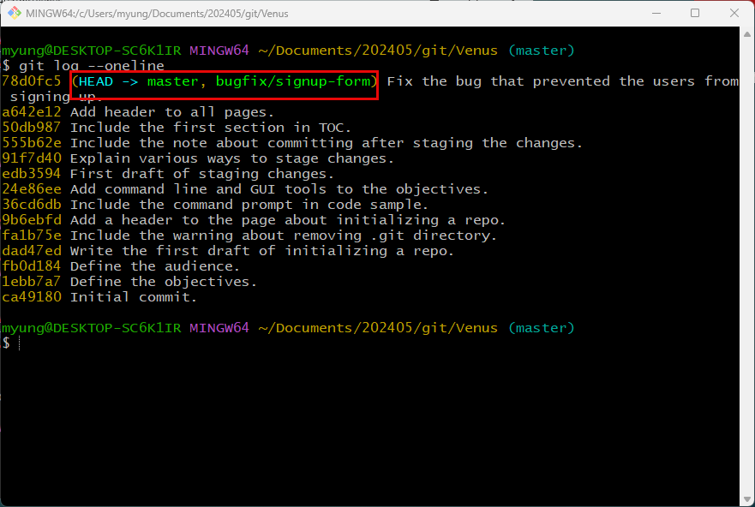
We can see that the master pointer moved forward.
Now, two branches are pointing to the same commit, which is the most recent commit.

Slide 38
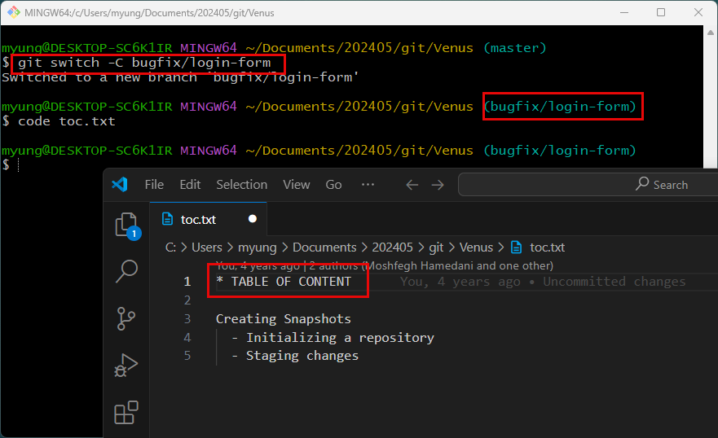
Using No Fast-Forward Option
By using switch command, you can create a new branch and switch to the branch at the same time.
And make some changes on the new branch.

Slide 39
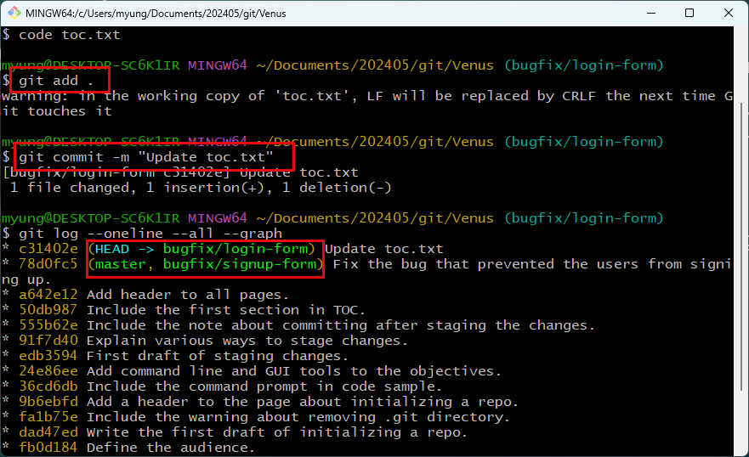
After committing the changes, new branch is one commit ahead of master.
We can drop the old bugfix branch.
We can merge the master and bugfix/login-form branches with no Fast-Forward option.

Slide 40
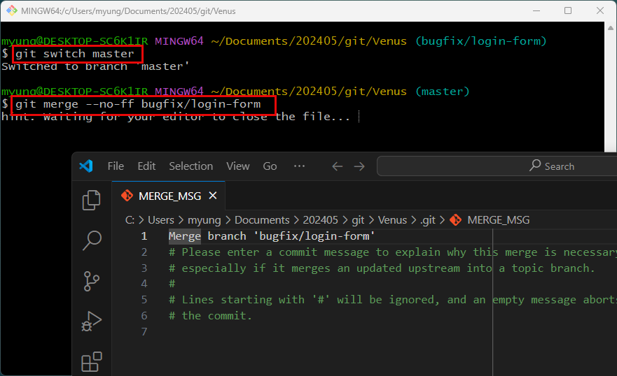
Switch to master first
If you merge the bugfix/login-form branch using ‘--no-ff’ option, it will merge two branches by creating a new commit. And, it will launch VS Code so that you can edit the merge message.

Slide 41
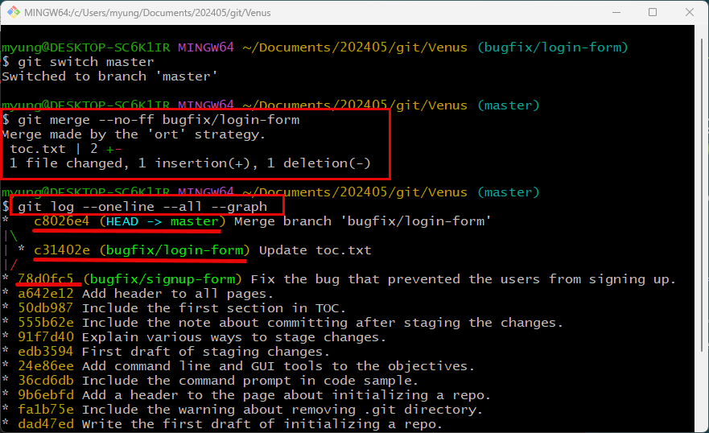

Slide 42

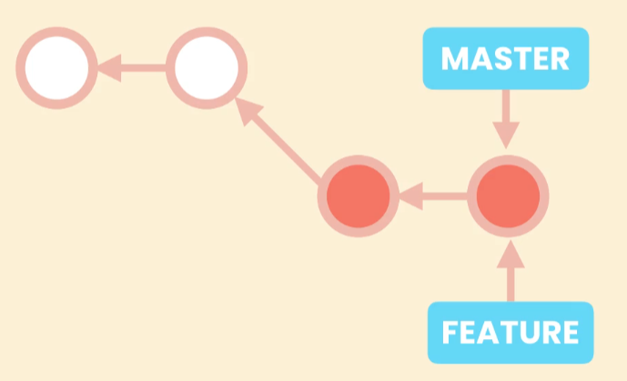
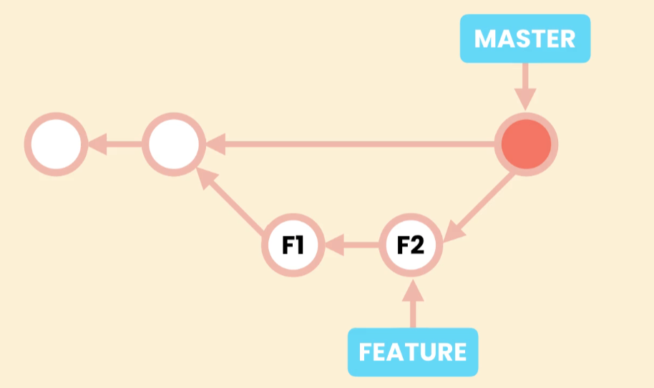
Merging with --no-ff option

Slide 43
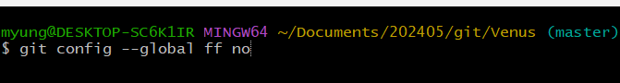
If your team doesn’t allow fast-forward merge, you can change the configuration using the above command.

Slide 44
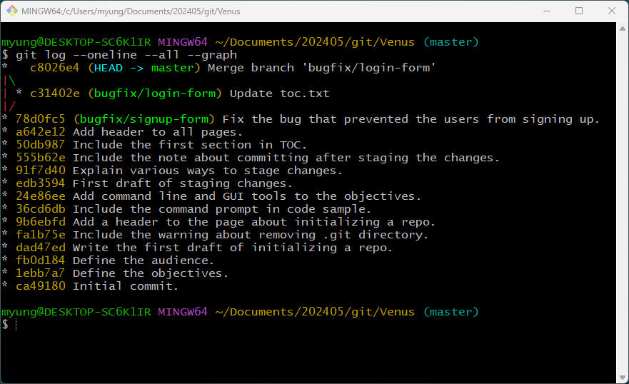
3-Way Merges
Current status – three branches

Slide 45
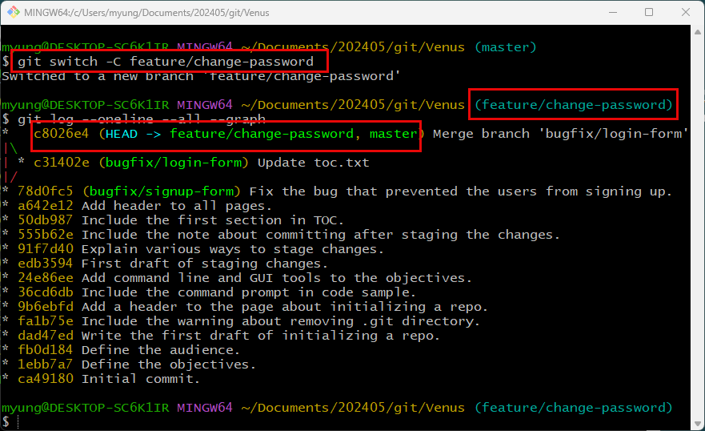
Create a new branch and switch to it.
Both new branch and master branches point to the last commit.

Slide 46
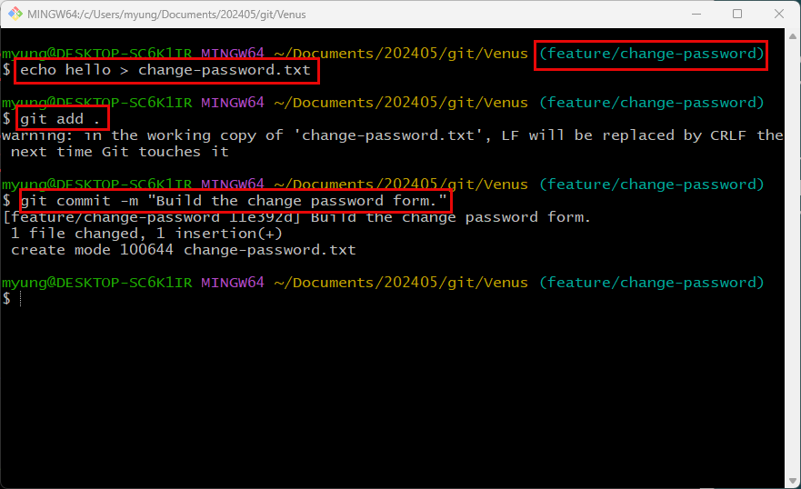
Create a new file in the new branch.
Commit the changes.

Slide 47
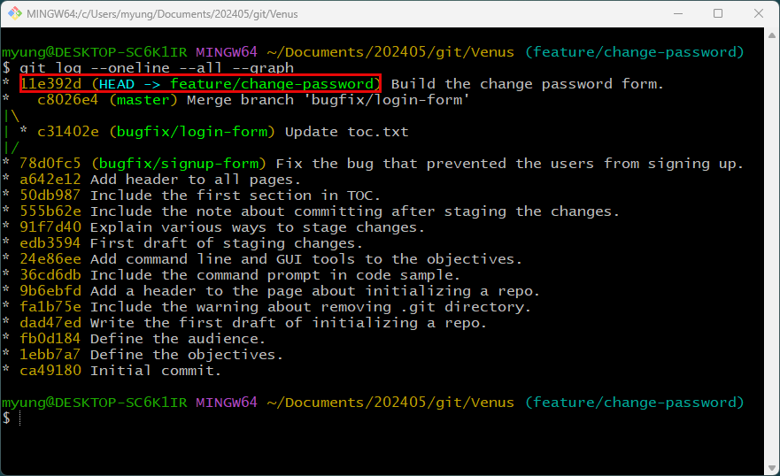
Now, the new branch points to the last commit.
The master branch points to the previous commit.
There is no diverge yet.

Slide 48
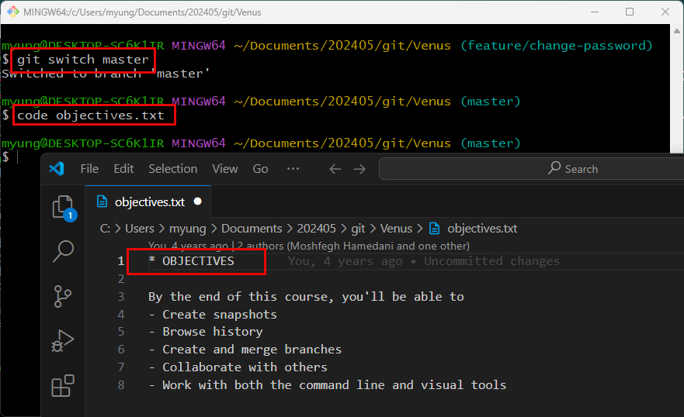
To make two branches diverged, switch to the master branch and make some changes.

Slide 49
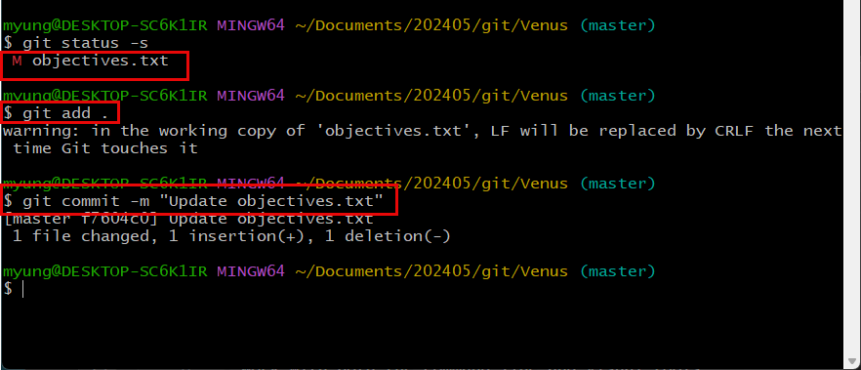
And stage the changes and commit them.

Slide 50
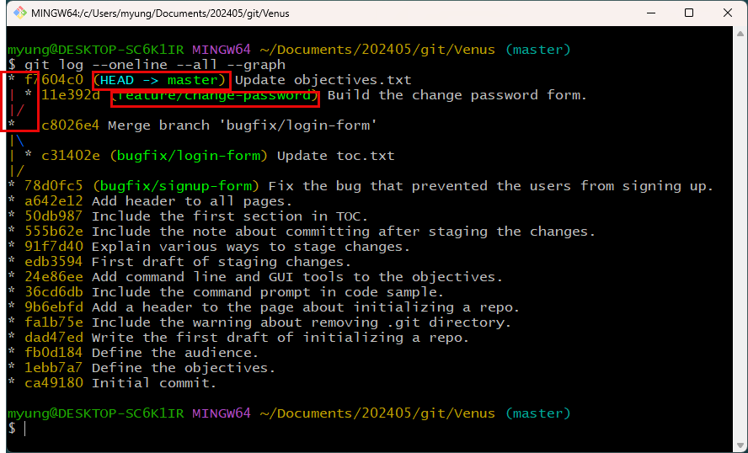
Now, two branches have diverged.
We need to use 3-way merge.

Slide 51
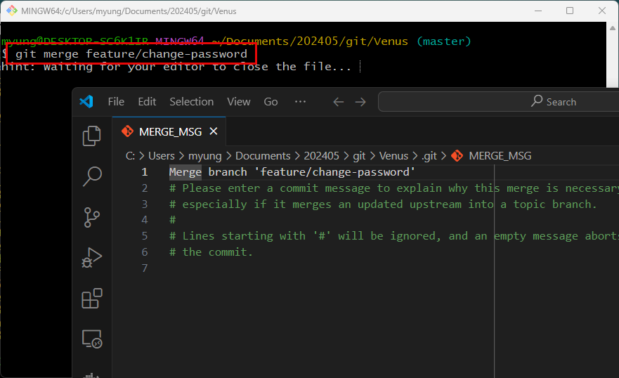
In the master branch, if you merge them, 3-way merge method is applied.
And it will launch VS Code to allow you to edit the merge message.

Slide 52

Now, you will see that 3-way merge was done successfully.

Slide 53

Viewing the Merged Branches
The first three branches were merged to the aster branch, and they can be safely removed.

Slide 54


You can delete them by using –d option.
You also can see the unmerged branches using ‘--no-merged’ option.
Currently, there is no unmerged branches.

Slide 55
Merge Conflicts
Conflicts
Change1, Change2 on the same file.
Change and Delete
Add1 and Add2 using the same filename.

Slide 56

Merge Conflicts
Create a new branch named ‘bugfix/change-password’.
And make some changes in a file.

Slide 57

Stage and commit the changes.

Slide 58

Switch to the master branch and modify the same file, change-password.txt.

Slide 59

Stage and commit the changes in the master branch.
Now, the same file was modified across the branches.

Slide 60

Now two branches have diverged.

Slide 61

When trying to merge the two branches, git shows a conflict error and shows where conflicts happen.

Slide 62


If you open the file using VS Code, it displays the content from both branches.
The content above the '=====' line indicates it is from the current branch, while the content below the line indicates it is from the other branch.
There are many ways to handle this situation.
Accept Current Change
Accept Incoming Change
Accept Both Changes
Or change manually

Slide 63

Once resolving the conflicts and save the file in VS Code, you need to stage the file(s) so that there no longer exist unmerged paths.
Then commit and edit/choose the default merge message.
If you close VS Code, you are done with merging.

Slide 64


Slide 65
Graphical Merge Tools
Kdiff3
DiffMerge
Semantic Merge
…

Slide 66
Aborting a Merge
To abort a merge, you can simply type as follows:
> git merge --abort

Slide 67
Undoing a Faulty Merge
Option 1: Remove the merged commit as if it was never there.
Should be careful since it is rewriting the history.
If it is local, it is fine to rewrite the history. But if it involves other team members’ work, then should be careful and should not rewrite the history.
Option 2: Revert the merged commit.

Slide 68


Removing the Last Commit
You can move the pointer to the previous commit using ‘reset’ command.
This commit becomes a garbage and automatically removed.

Slide 69

Removing the Last Commit
We will remove the last commit.
And restore it back.
(for this purpose, store the commit ID 83e452c)

Slide 70




Resetting Options
Soft (default):
Git just moves the pointer of the last snapshot to a different snapshot and doesn’t affect staging area and working directory.
Mixed
Git gets a new snapshot and put it in the staging area as well. Working directory is not affected.
Hard
Git gets a new snapshot and put it in all three areas. So, all three areas are affected, and they are going to look identical.

Slide 71

We reset using ‘--hard’ option to the previous commit (86963f1)of the master branch.
The previous last snapshot was gone in the history.
But the snapshot is still in the repository so that you can restore just in case.

Slide 72

By using the ID of the previously deleted commit (86963f1)of the master branch, you can restore the last commit back.

Slide 73
Be Careful with Removing the Last Commit/Snapshot
This can be done only for local repositories safely.
For remote repositories, especially for team projects, you should be very careful because it rewrites the history.
So, if the repository is for shared work, you would need to revert the last commit.

Slide 74

Revert the Last Commit
When trying to revert the last commit, you will get an error.

Slide 75

You must tell how you want to revert because there are two destinations.
We are going to revert to the first parent of the master branch.

Slide 76

‘-m 1’ means the first parent of the master branch.
Also, git opens VS Code so that revert message can be edited.

Slide 77

Git creates a new commit by reverting the last merged commit.

Slide 78




Squash Merging
After merging branches, two commits (B1 & B2) in the bugfix branch are not good quality commits and you want to get rid of them.
In this case, you can undo the merge.
Create a new commit by combining the two commits (B1 & B2) of the bugfix branch.
It will create a single logical chain set in the main branch.
It should be used for short-lived and bad branches.

Slide 79

Create a new branch
Modify a file in the new branch
Stage and commit the change

Slide 80

Make one more commit
We will do squash merging.

Slide 81

Switch to master branch
Merge two branches using ‘--squash’ option.
But new commit was not made, and all changes are now in the staging area.

Slide 82

If you commit the changes, a new snapshot that combines all the changes will be created.

Slide 83

As you can expect, the bugfix/photo-upload branch is not in the list of merged branches.
But it is in the list of un-merged branches.
You will have to forcefully delete the branch using ‘-D’ option.

Slide 84

Now the bugfix/photo-upload branch was gone.

Slide 85




Rebasing
If you want to make two commits in the feature branch as a part of the master branch.
It is called ‘rebasing’

Slide 86



Rebasing
Rebasing rewrites history.
Should be cautious.
Good for local repositories.
For shared repository, you should be very cautious.
Since commits are immutable, it will create new commits and they are not the same commits that were originally created.

Slide 87

Create a new branch and add a new file. Then commit the change.

Slide 88

A new snapshot was created.

Slide 89

Switch to master branch
Modify a file and commit the change
The two branches will diverge.

Slide 90

Two branches have diverged.

Slide 91

Switch to the feature/shopping-cart branch and rebase the master branch.
Branches are no longer diverged.
It will create a linear path connected to the master branch.

Slide 92

Switch to the master branch.
Merge the feature/shopping-cart branch.
Then two branches will be successfully merged using fast-forward method.

Slide 93


Cherry Picking
It is to use a specific commit.

Slide 94


Slide 95

Now two branches are diverged.
We will use the commit of the feature/change-form branch for the master branch without merging them.
So, copy the commit ID (52f9311) to copy the commit to the master branch.

Slide 96

You can cherry-pick the commit in the feature/change-form branch by using its ID.
It will raise a conflict error since the same file was modified across the branches.
You can resolve it by using VS Code.

Slide 97

Resolve the conflict.

Slide 98

UU means updated but unmerged

Slide 99


Slide 100

Picking a File from Another Branch (not whole commit)
Create a new branch named ‘feature/send-email’
Add and commit a file named ‘toc.txt’

Slide 101

To bring the ‘toc.txt’ file to the master branch, switch to master branch.
Use ‘restore’ command and ‘--source’ option to specify the source branch.
Should use ‘--’ before the file name.

Slide 102

Working with Branches in VS Code
Source Control

Slide 103

GitLens

Slide 104

Create a new branch named ‘feature/reset-password’

Slide 105


Slide 106


Slide 107


Slide 108


Slide 109


Slide 110


Slide 111


Slide 112

Switch to master branch

Slide 113

To create a conflict, in the master branch, modify toc.txt file and commit.

Slide 114


Slide 115

Now two branches have diverged

Slide 116

If you right-click ‘reset-password’ branch and select ‘Merge Branch into Current Branch..’, it will let you choose a merge type.
If you choose the default ‘Merge’, it shows this conflict.

Slide 117

Stage changes and commit

Slide 118

Now two branches are merged.

Slide 119
Summary

Slide 120
Exercises

